Slide 1




The Right Way - Architecture
Thin Controllers, Areas, Inversion of Control, JMS
The Right Way
SoftUni Team
Technical Trainers
Software University
http://softuni.bg

Slide 2

Table of Contents
Inversion of Control
Areas
Thin Controllers
Java Message Service

Slide 3
Have a Question?
sli.do #JavaWeb

Slide 4

Inversion of Control
Constructor vs Field Injection

Slide 5

Field Injection
Easy to write
Easy to add new dependencies
It hides potential architectural problems!
@Autowired
private ServiceA serviceA
@Autowired
private ServiceB serviceB
@Autowired
private ServiceC serviceC
Notes:
http://www.thymeleaf.org/doc/tutorials/3.0/usingthymeleaf.html

Slide 6

Constructor Injection
Time Consuming
Harder to add dependencies
It shows potential architectural problems!
@Autowired
public ControllerA(ServiceA serviceA, ServiceB serviceB, ServiceC serviceC) {
this.serviceA = serviceA;
this.serviceB = serviceB;
this.serviceC = serviceC;
}
Notes:
http://www.thymeleaf.org/doc/tutorials/3.0/usingthymeleaf.html

Slide 7
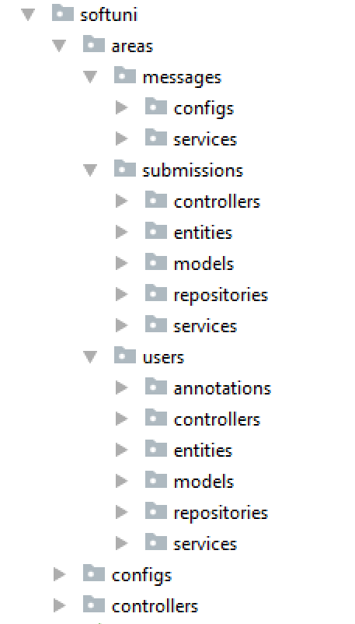
Areas
Dividing code by business logic

Slide 8
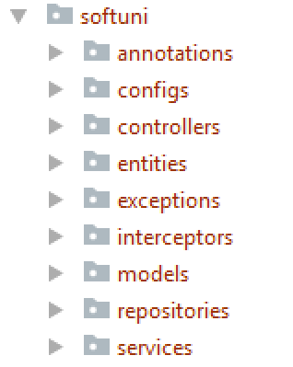
Code Areas
We are used to splitting our code based on its functionality:
It gets hard to navigate in bigger applications

Slide 9
Code Areas (2)
Splitting the application code by business logic makes it easier to navigate

Slide 10

Thin Controllers
Creating Simple Components

Slide 11
Thin Controllers
Controllers should follow well known principles such as DRY and KISS
Should delegate functionality to the model layer
The model layer consists of application logic, e.g. services, executors, strategies, mappers, DTOs, entities, etc.

Slide 12
Thin Controller Example
@PreAuthorize("isAuthenticated()")
@GetMapping("{id}")
public String details(Model model, @PathVariable Long id) {
GameDetailsView game = gameService.get(id);
model.addAttribute("view", "games/details");
model.addAttribute("game", game);
model.addAttribute("title", game.getTitle());
return "base-layout";
}

Slide 13
JMS
Java Message Service
Message Sender
Message Receiver
Sending message between applications

Slide 14
JMS - What we need?
Apache ActiveMQ
JAVA_HOME should be set as enviroment variable
Dependencies:
<dependency>
<groupId>org.springframework.boot</groupId>
<artifactId>spring-boot-starter-activemq</artifactId>
</dependency>
<dependency>
<groupId>org.apache.activemq</groupId>
<artifactId>activemq-broker</artifactId>
</dependency>

Slide 15
JMS - Connection Factory
Creating connection to the ActiveMQ service
String DEFAULT_BROKER_URL = "tcp://localhost:61616"; @Bean
public ActiveMQConnectionFactory connectionFactory() {
ActiveMQConnectionFactory connectionFactory = new ActiveMQConnectionFactory();
connectionFactory.setBrokerURL(DEFAULT_BROKER_URL);
return connectionFactory;
}

Slide 16
JMS - Sending Messages
You will need to create JmsTemplate Bean that will use the connection factory from the previous slide
String QUEUE = "message-queue";
@Bean
public JmsTemplate jmsTemplate(){
JmsTemplate template = new JmsTemplate();
template.setConnectionFactory(connectionFactory());
template.setDefaultDestinationName(QUEUE);
return template;
}

Slide 17
JMS - Sending Messages (2)
To send a message you only need to inject the bean and use the convertAndSend() method:
@Autowired
private JmsTemplate jmsTemplate;
public void sendMessage(final String message) {
jmsTemplate.convertAndSend(message);
}

Slide 18
JMS - Receiving Messages
To receive a message in the other application just use the @JmsListener annotation:
@JmsListener(destination = "message-queue")
public void readMessage(Message<String> message) throws JMSException {
System.out.println(message.getPayload());
}

Slide 19
Live Demo
Java Message Service
Message Sender
Message Receiver
JMS - Judge System

Slide 20

Summary
Constructor injection is the best way for Dependency Injection
Splitting your application code by business logic makes it easier to navigate in big projects
Every component of your Spring application should be as "thin" as possible
JMS lets multiple applications communicate

Slide 21








The Right Way - Architecture
https://softuni.bg/courses/java-mvc-frameworks-spring

Slide 22
License
This course (slides, examples, demos, videos, homework, etc.) is licensed under the "Creative Commons Attribution-NonCommercial-ShareAlike 4.0 International" license

Slide 23




Trainings @ Software University (SoftUni)
Software University – High-Quality Education, Profession and Job for Software Developers
softuni.bg
Software University Foundation
softuni.org
Software University @ Facebook
facebook.com/SoftwareUniversity
Software University Forums
forum.softuni.bg

